Slide 1
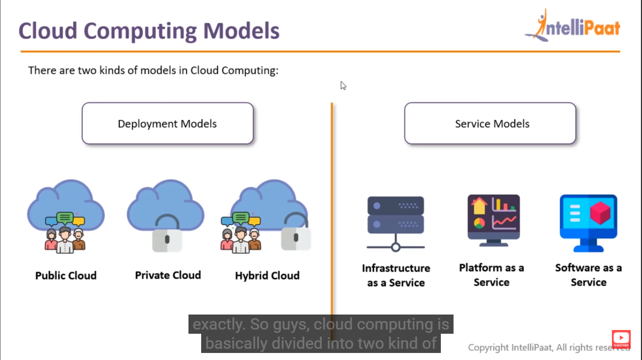
Cloud Computing Models

Slide 2
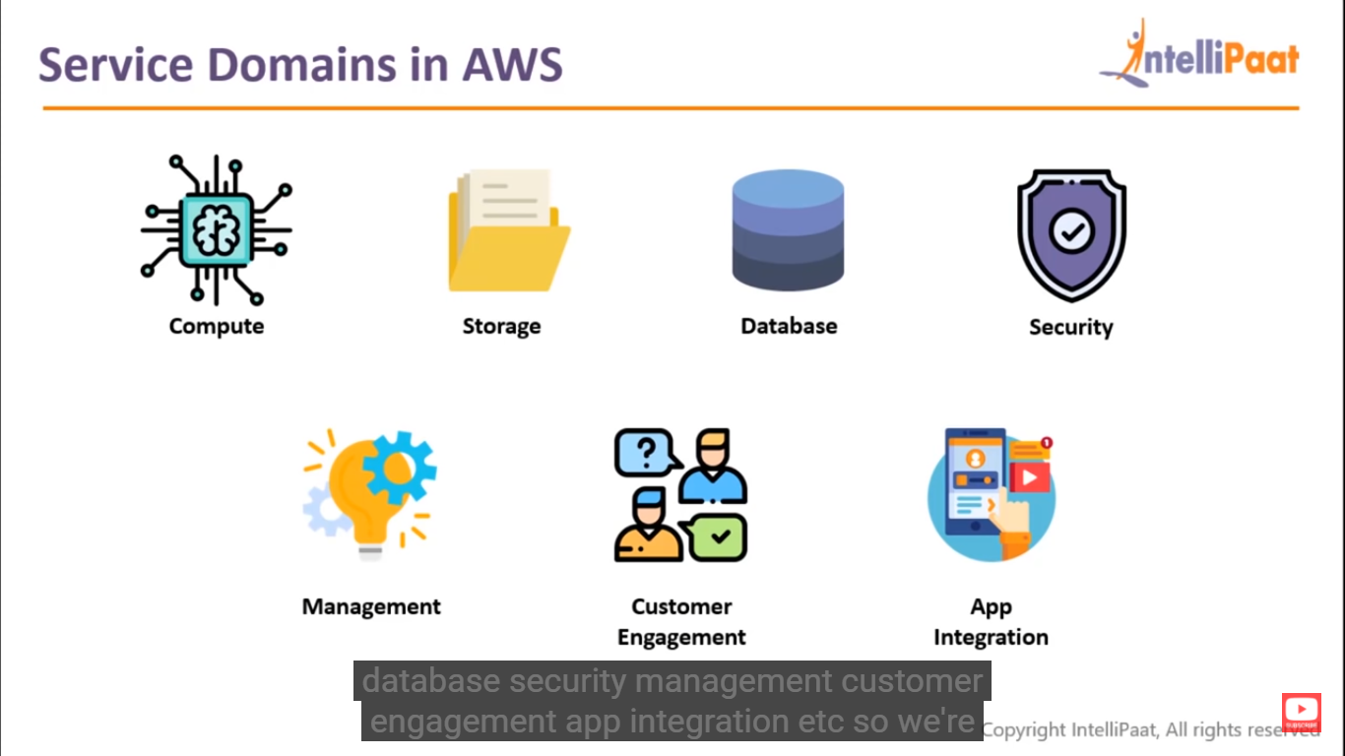
Service Domains in AWS

Slide 3
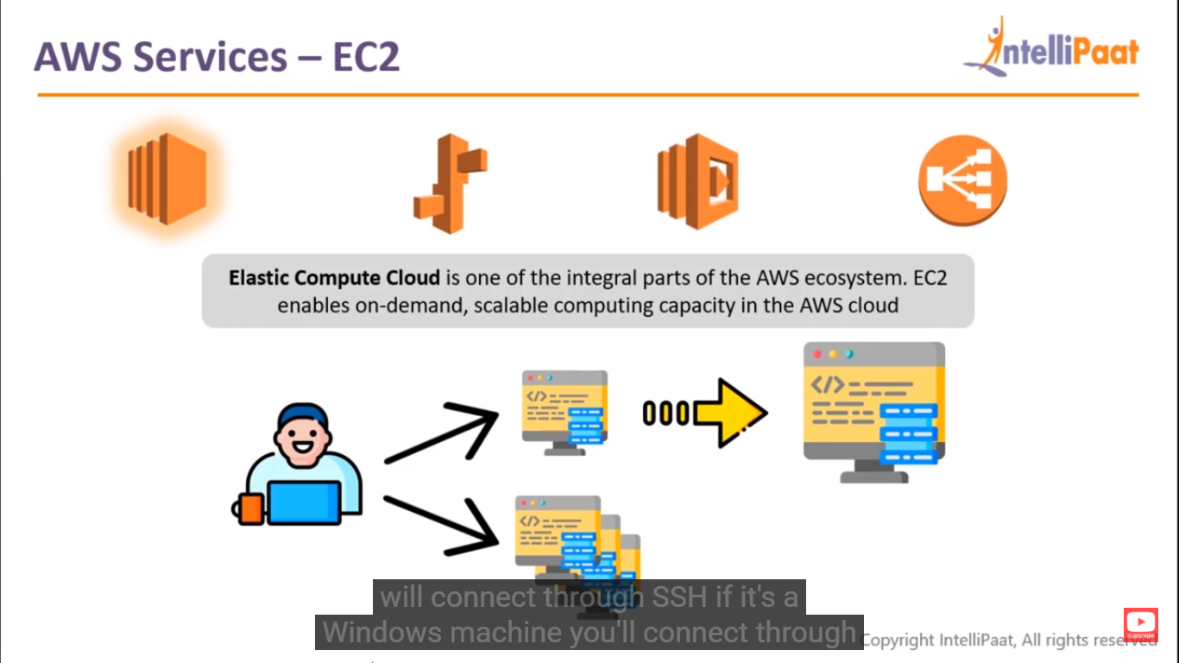
AWS Services = EC2

Slide 4
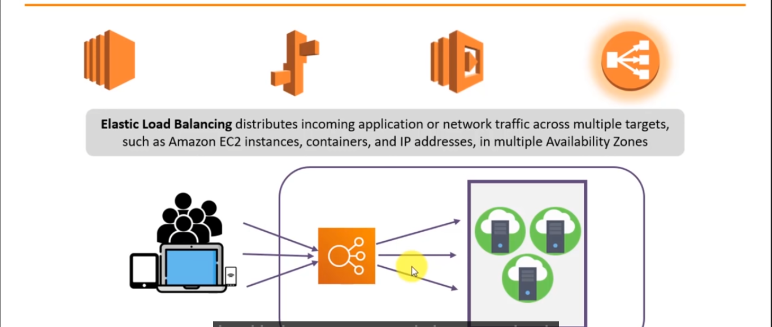
AWS Services – Elastic Load Balancing

Slide 5
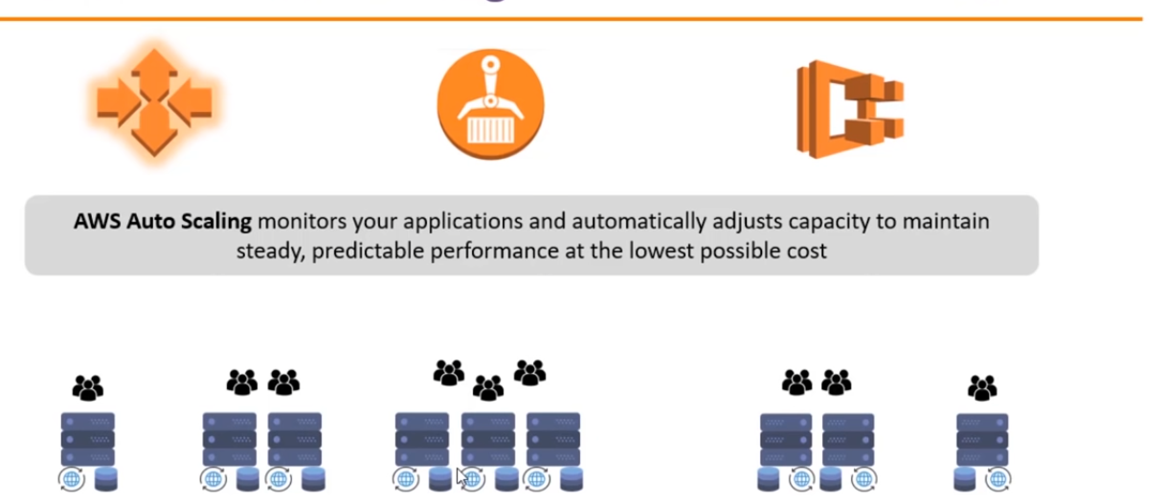
Aws Services – Auto Scaling

Slide 6
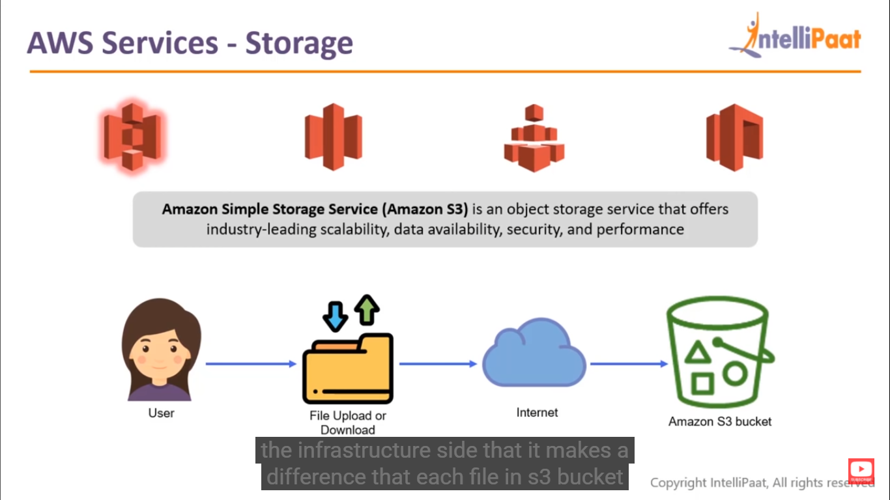
AWS services - Storage

Slide 7
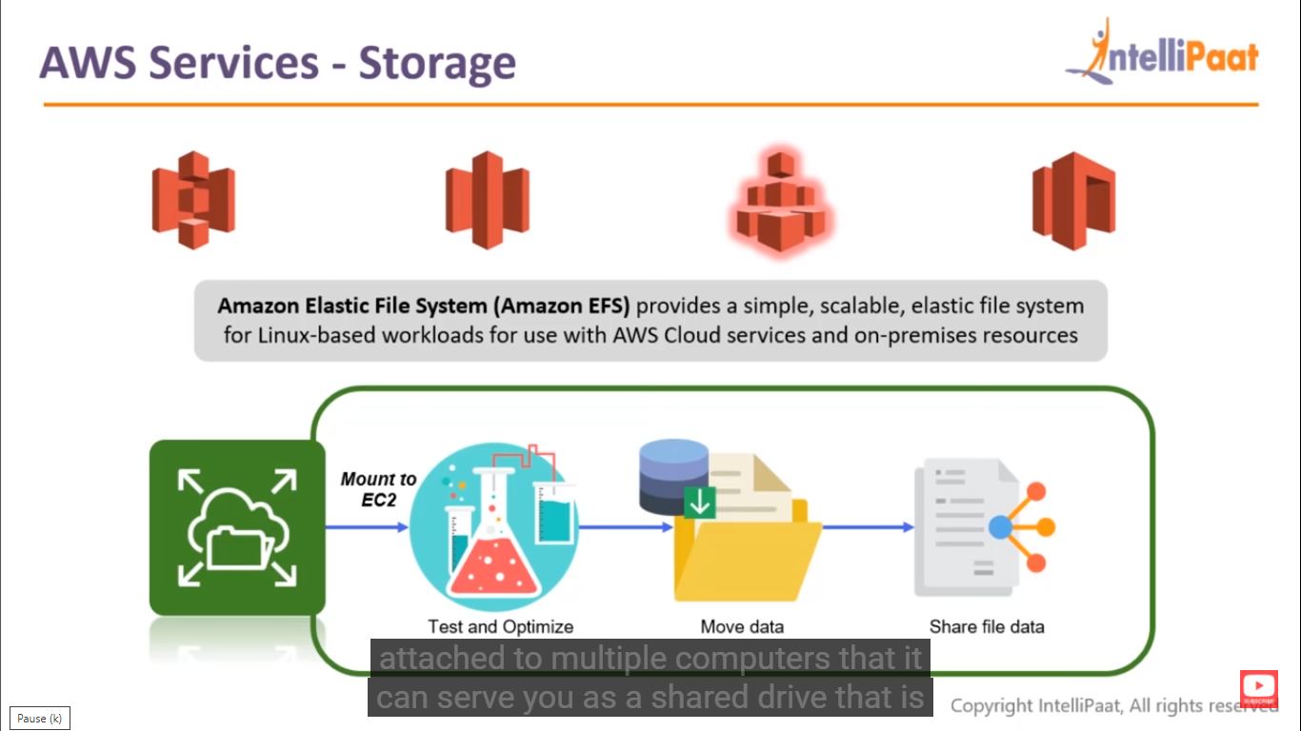
Aws Services -Storage

Slide 8
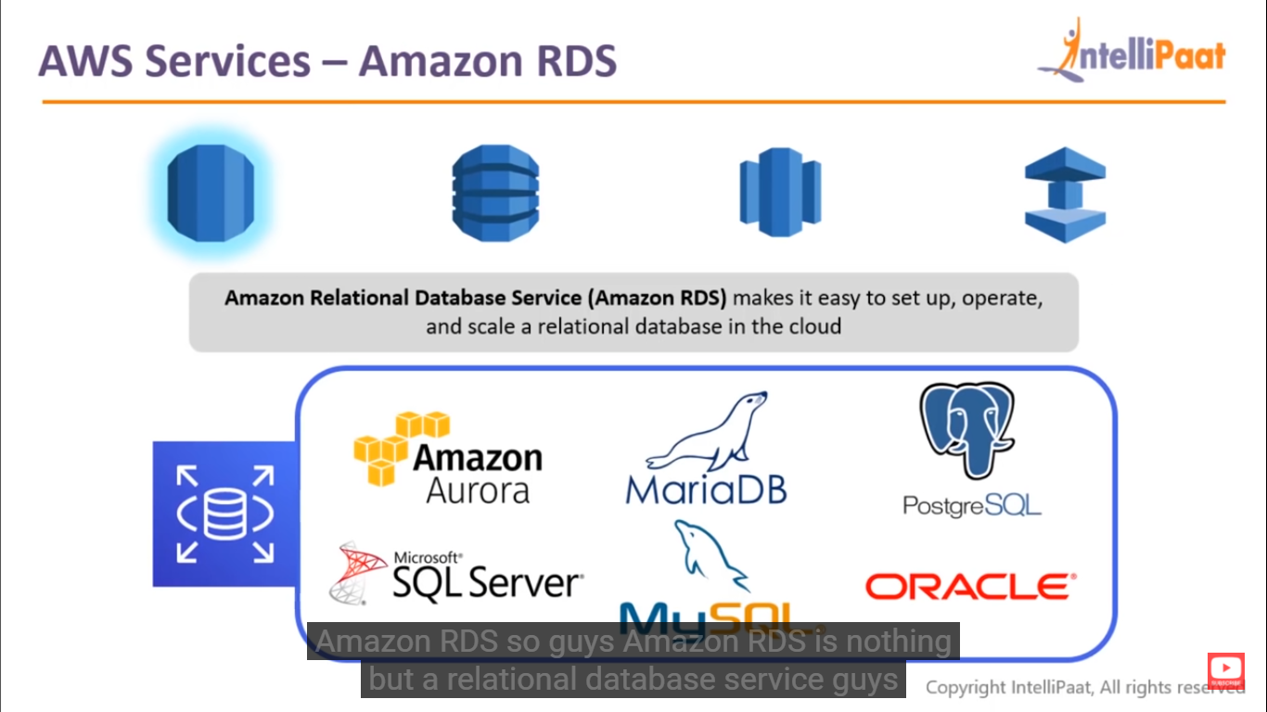
AWS services – Amazon RDS

Slide 9
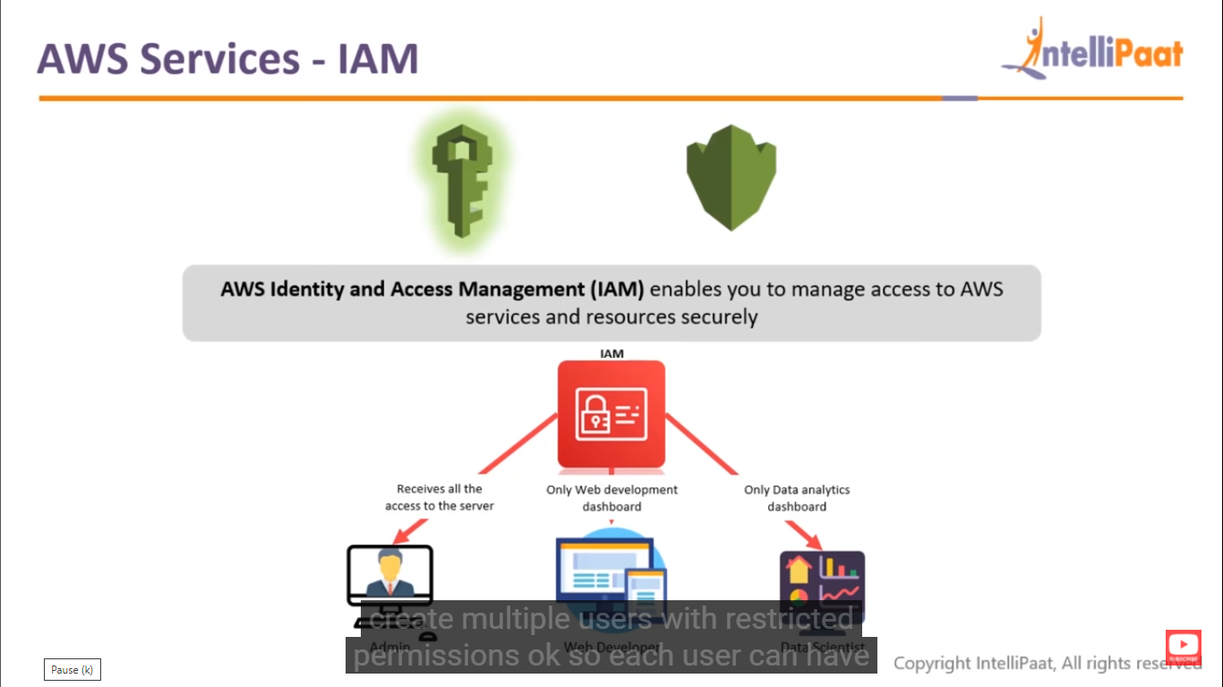
AWS Services - IAM

Slide 10
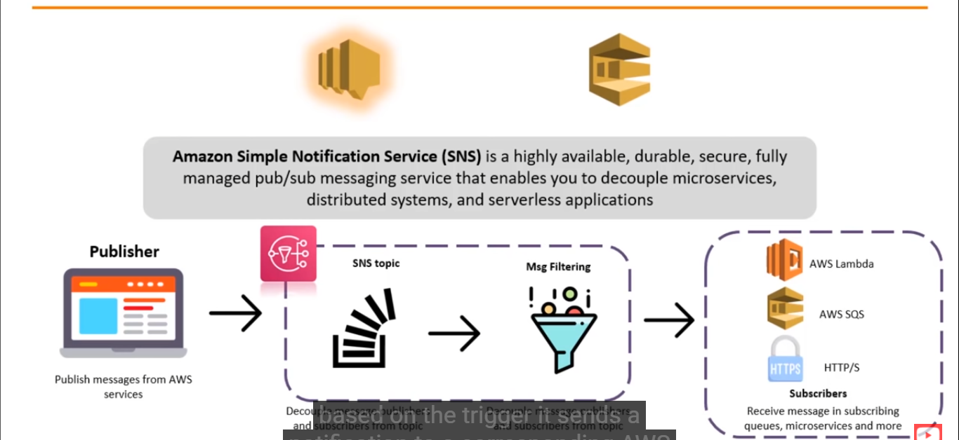
AWS Services – Simple Notification Service

Slide 11
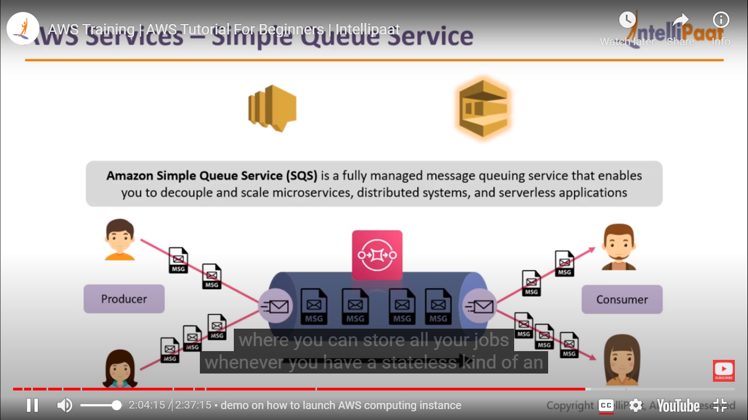
Aws Services – Simple Queue Service

Slide 12
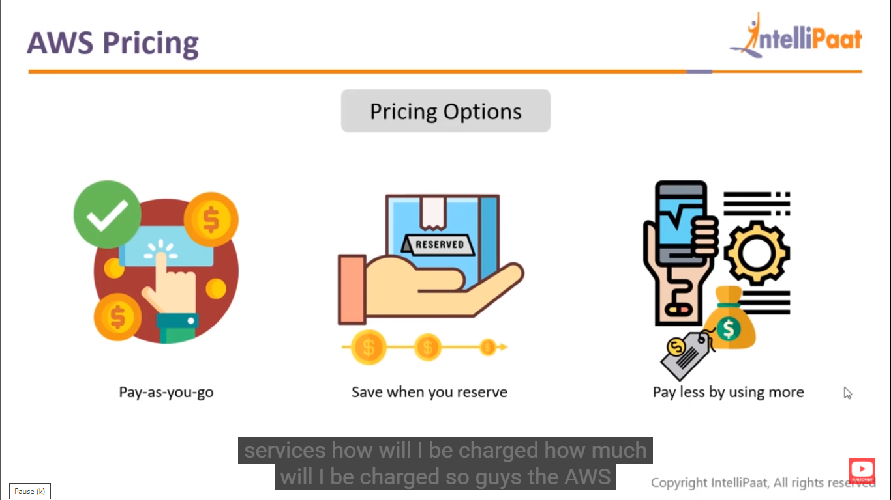
AWS Pricing

Slide 13
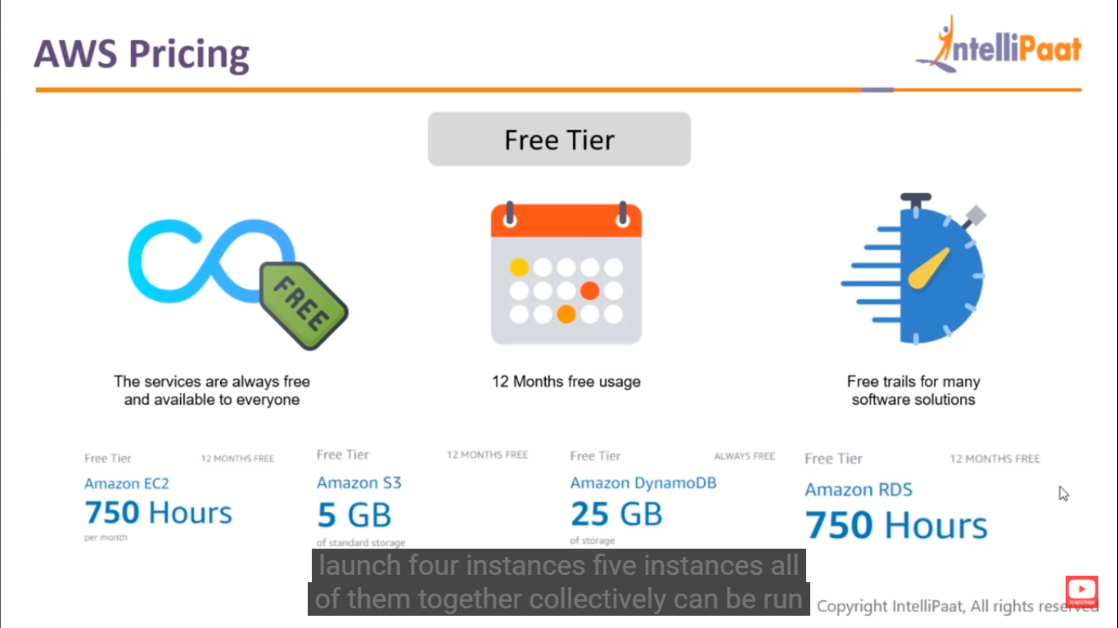
AWS Pricing

Slide 14
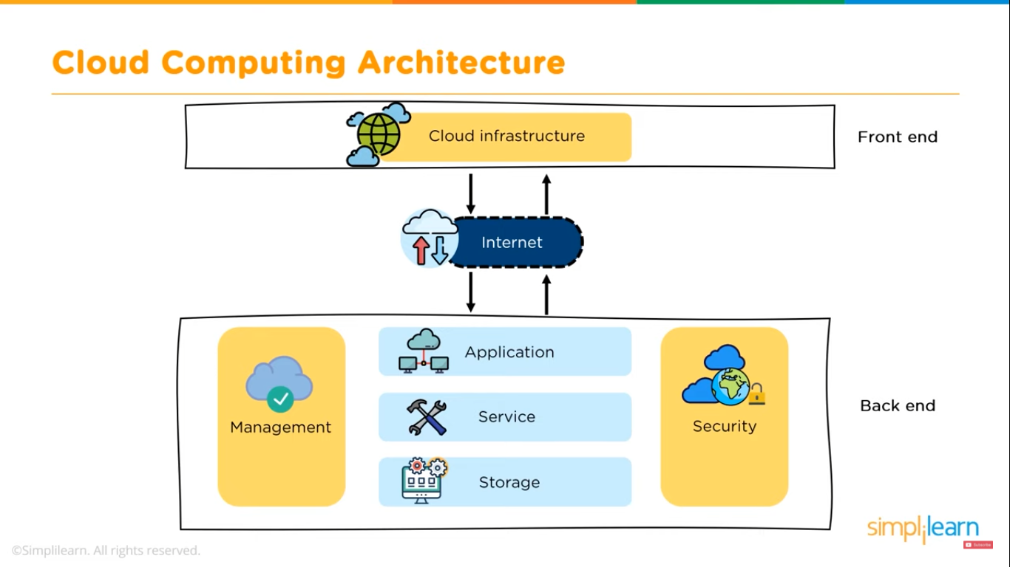

Slide 15
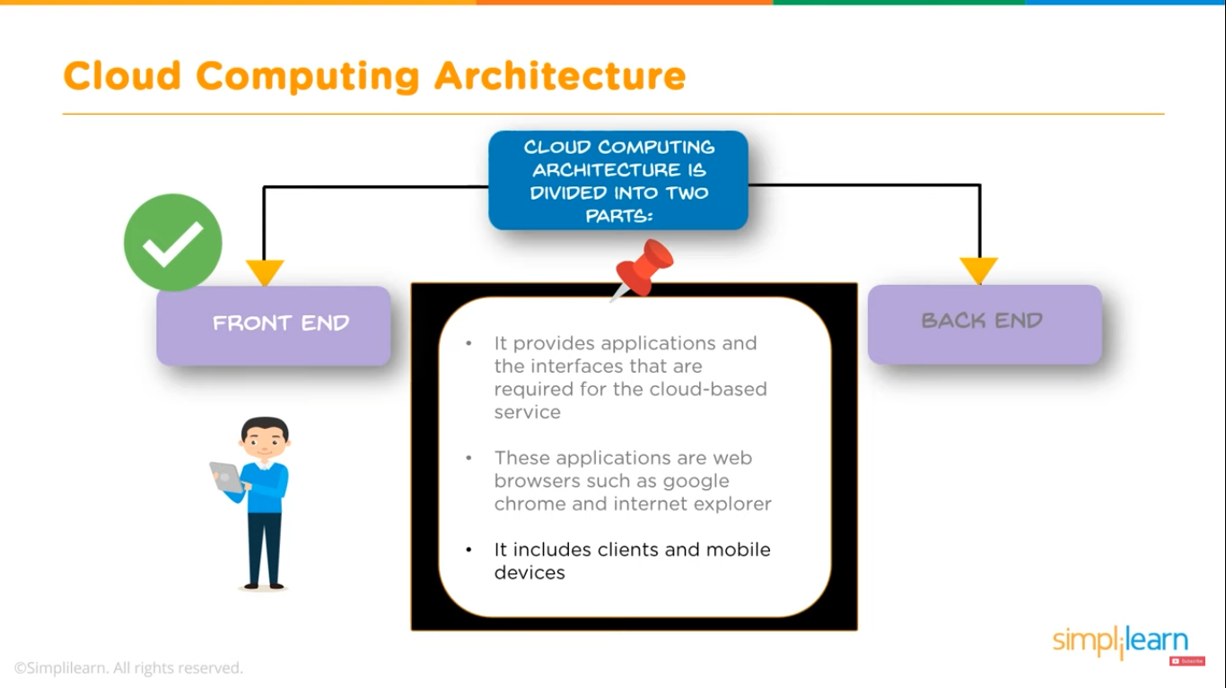

Slide 16
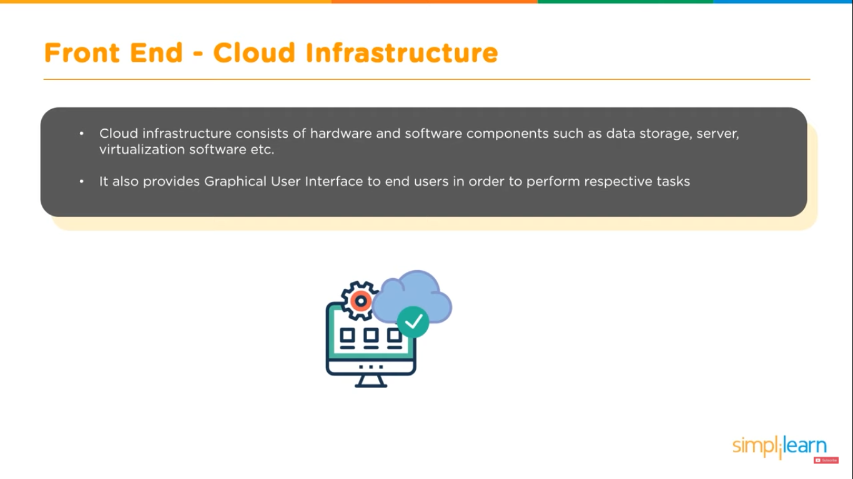

Slide 17
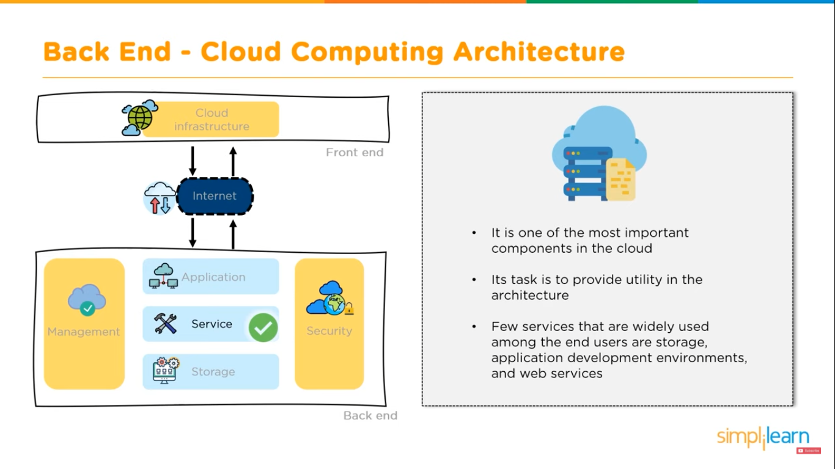

Slide 18
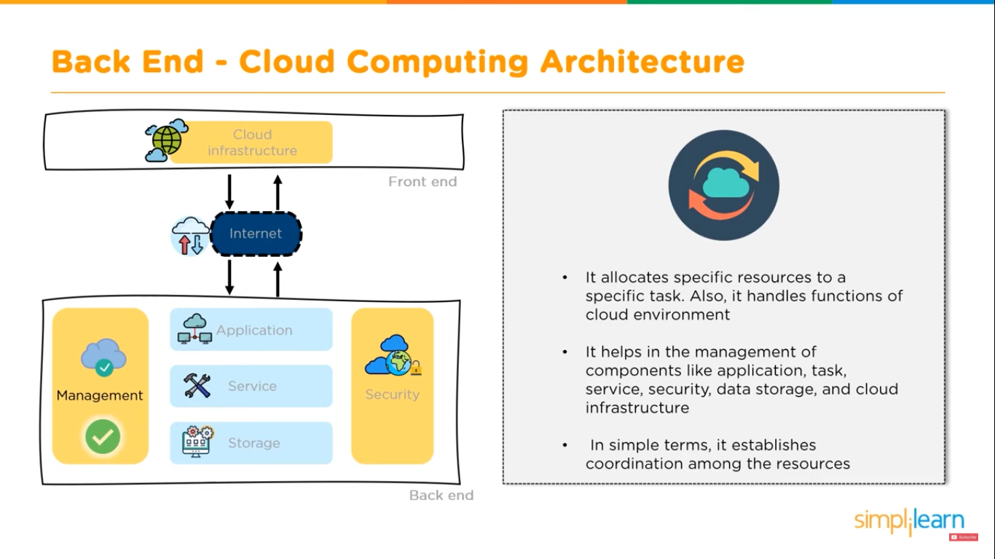

Slide 19
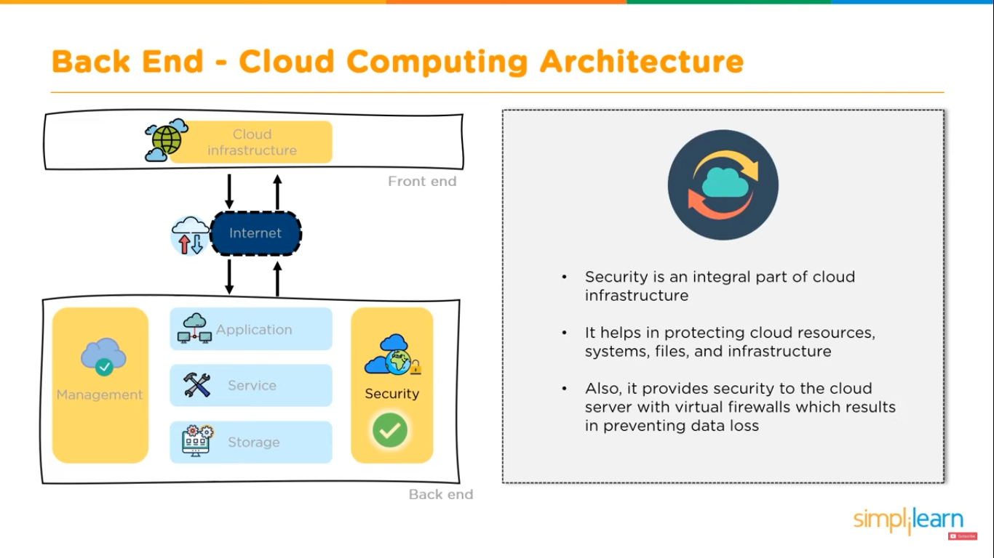

Slide 20
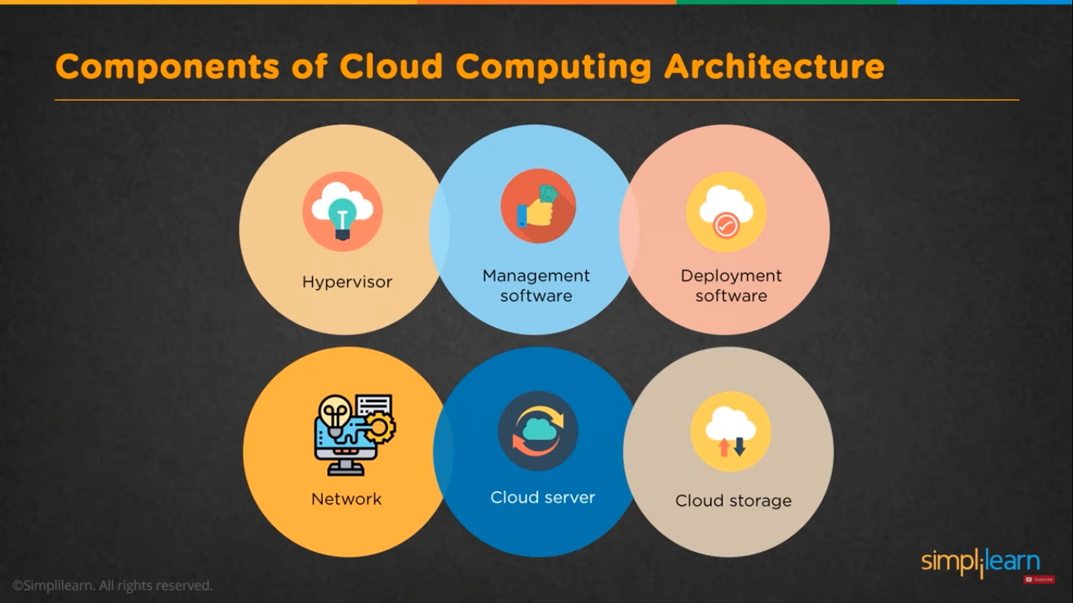

Slide 21
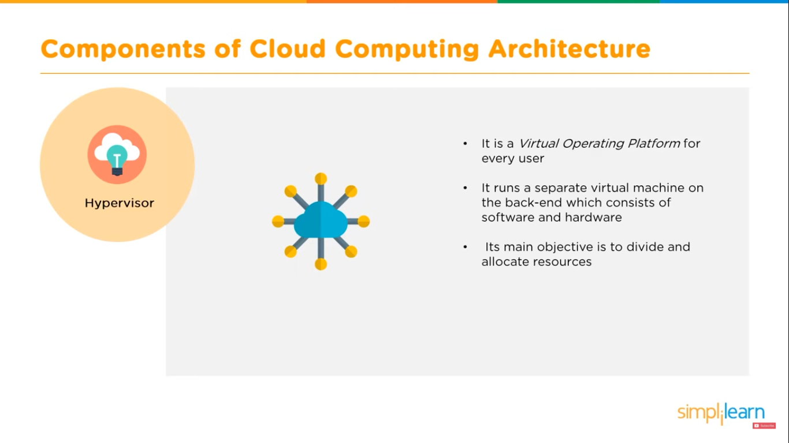

Slide 22
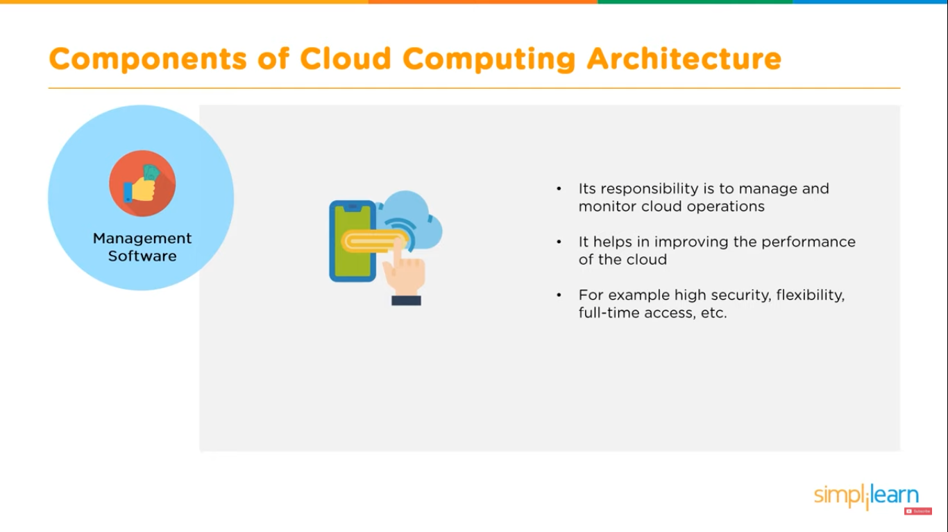

Slide 23
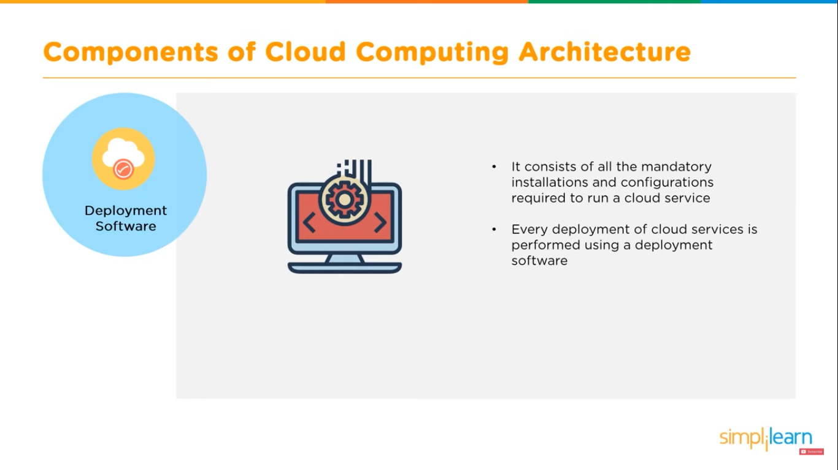

Slide 24
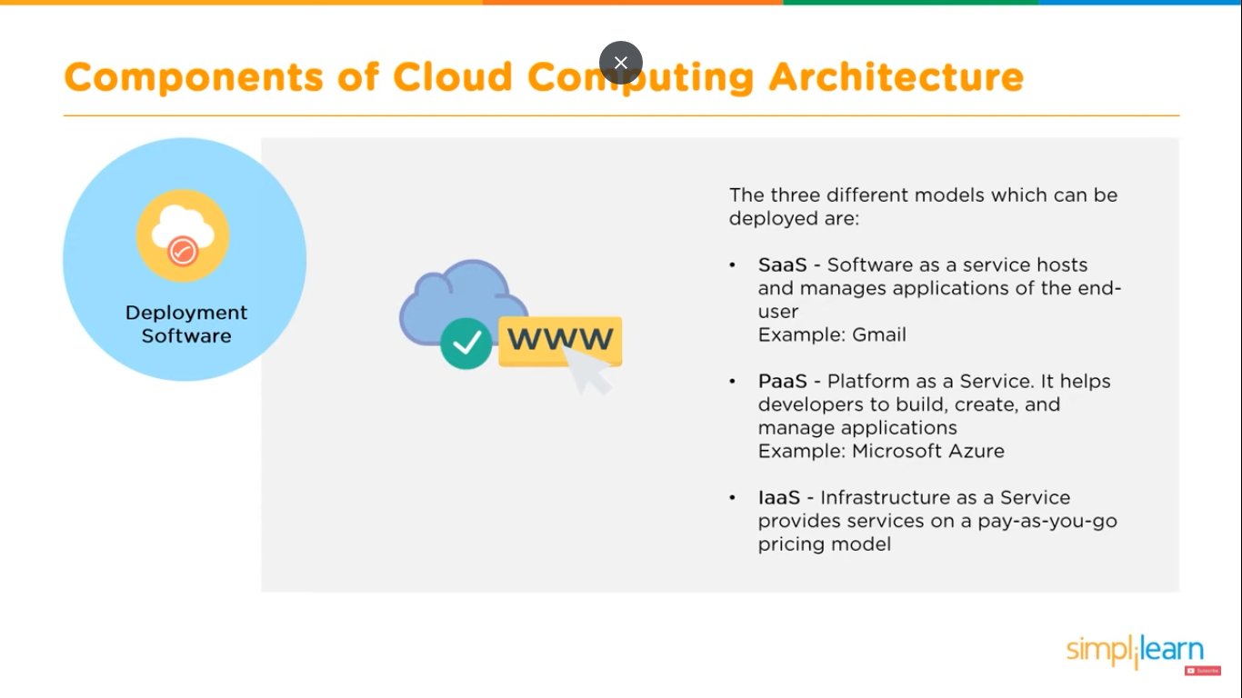

Slide 25
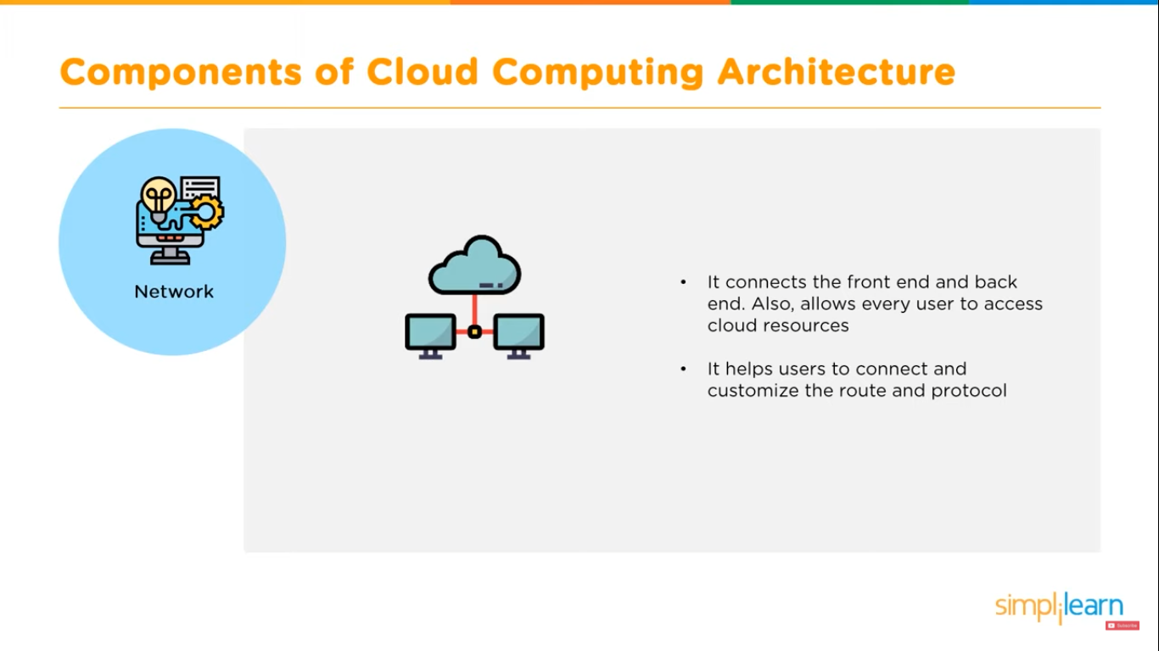

Slide 26
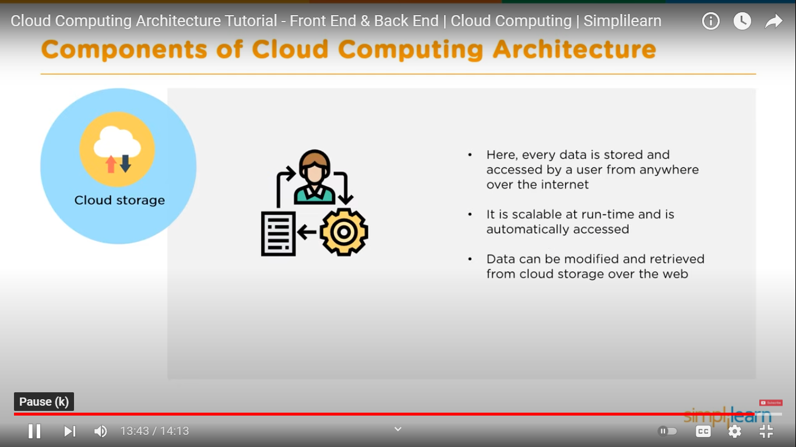

Slide 30

Elastic Compute 2

Slide 31
What is Ec2?
Amazon EC2 is a web service that provides resizable compute capacity in the cloud. Amazon EC2 reduces the time required to obtain and boot new server instances in minutes, allowing you to quickly scale capacity, both up and down, as your computing requirements change.

Slide 32
Virtualization
Virtualization is the process of creating a virtual version of something rather than the actual version of that thing.
In AWS Ec2, virtualization refers to using a portion of a server’s computing power and storage to setup and run an OS
Virtualization for EC2 is running the Xen Hypervisor software
The maintenance of the physical AWS server and the Xen hypervisor is handled by AWS

Slide 33
Ec2 Options?
On Demand – allow you to pay a fixed rate by the hour with no commitment short term
Reserved – provide you with a capacity reservation, and offer a significant discount on the hourly charge for an instance. 1 year to 3 year terms
Spot – enable you to bid whatever price you want for instance capacity, providing for even greater savings if your applications have flexible start and end times
Dedicated Hosts – Physical EC2 server dedicated for your use. Dedicated hosts can help you reduce costs by allowing you to use your existing server-bound software license.

Slide 34
On Demand
Users that want the low cost and flexibility of Amazon EC2 without any up-front payment or long-term commitment
Applications with short term, spiky, or unpredictable workloads that cannot be interrupted
Applications being developed or tested on Amazon EC2 for the first time

Slide 35
Reserved
Applications with steady state or predictable usage
Applications that require reserved capacity
User able to make upfront payments to reduce their total computing costs even further

Slide 36
Spot
Applications that have flexible start and end times
Applications that are only feasible at very low compute prices
Users with urgent computing needs for large amounts for additional capacity

Slide 37
Dedicated Hosts
Useful for regulatory requirements that may not support multi-tenant virtualization
Great for licensing which does not support multi-tenancy or cloud deployments
Can be purchased On-demand.
Can be purchased as a Reservation for upto 70% off the On-demand price.

Slide 38
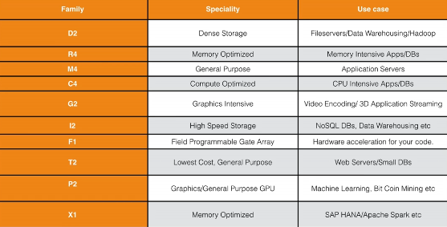
EC2 Instance Type

Slide 39
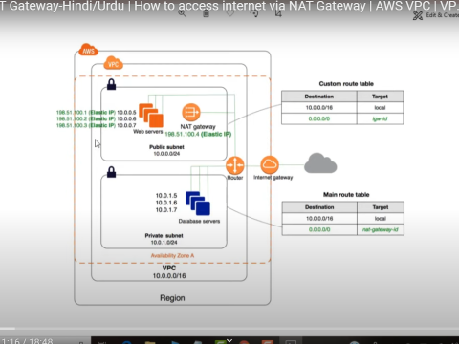
Aws – VPC( Access Internet Via NAT gateway)

Slide 40
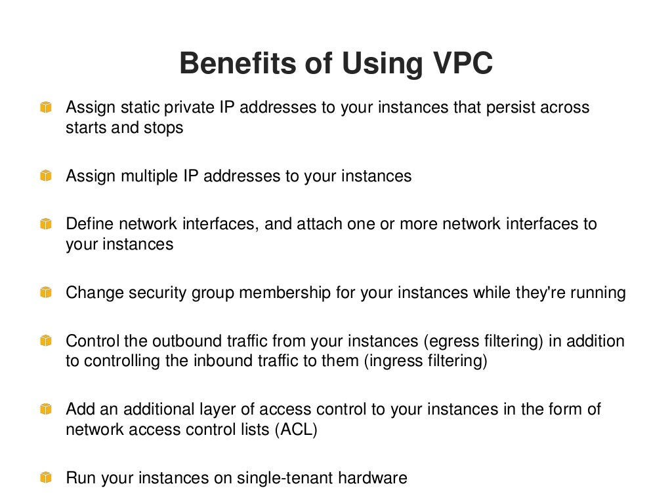

Slide 41
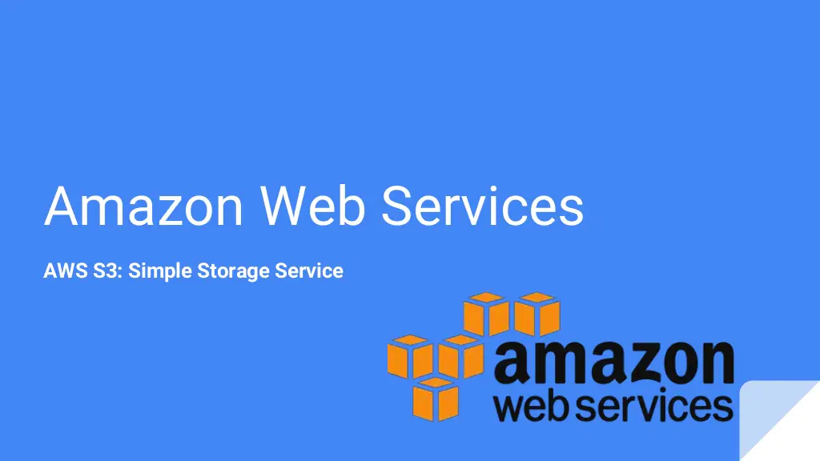

Slide 42
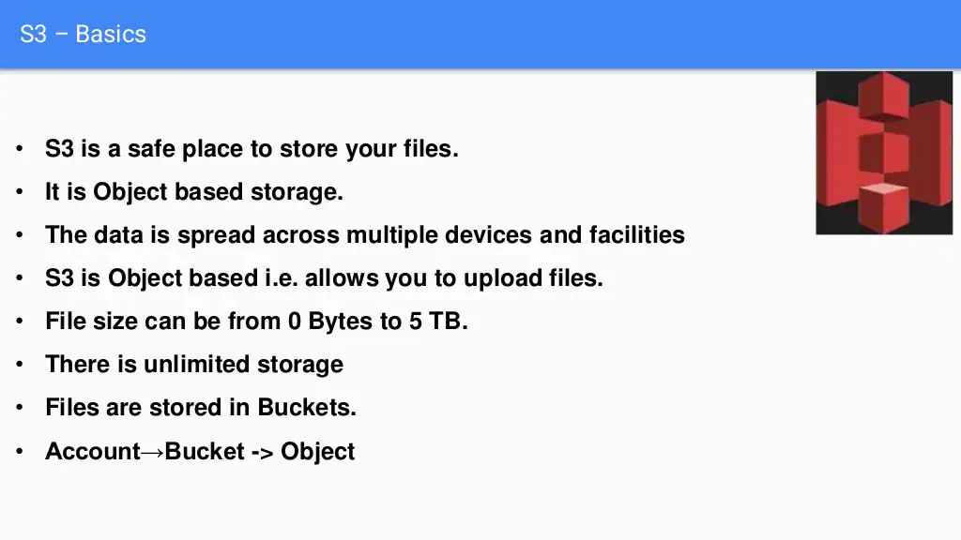

Slide 43
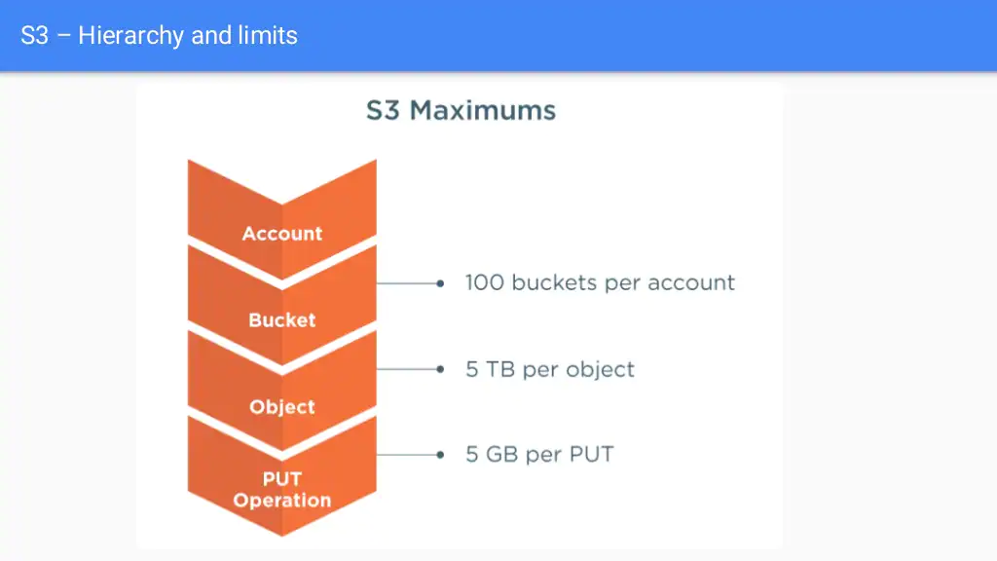

Slide 44
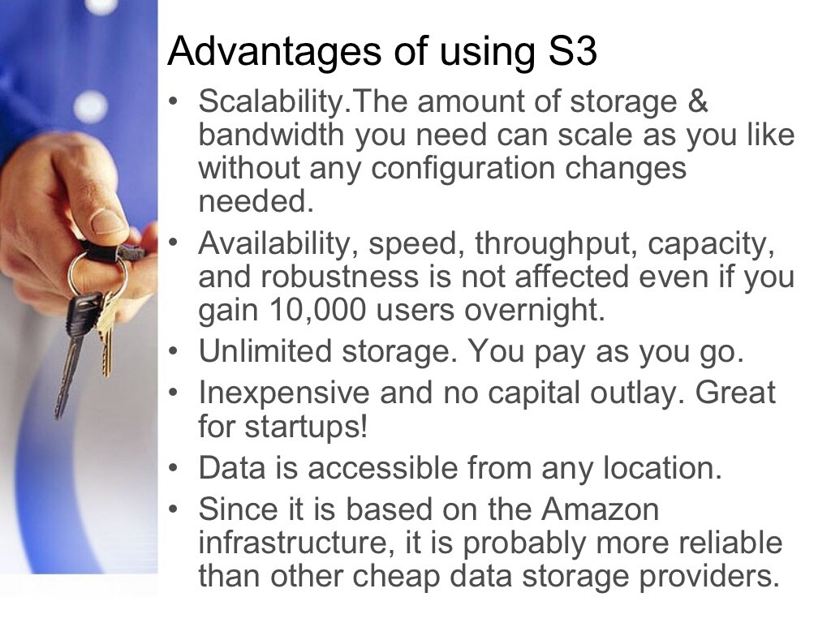

Slide 45
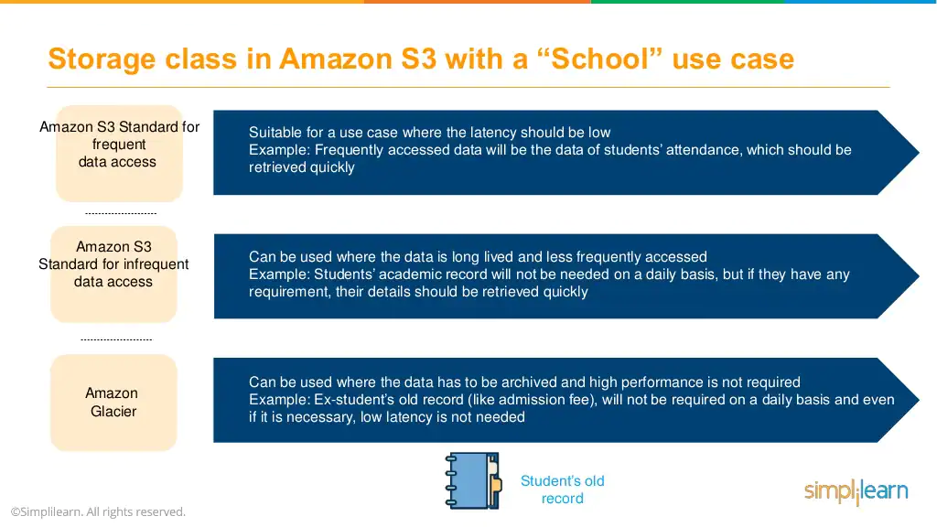

Slide 46
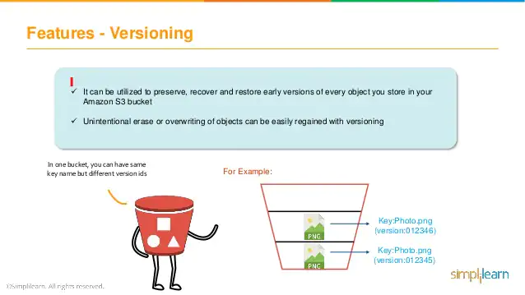

Slide 47
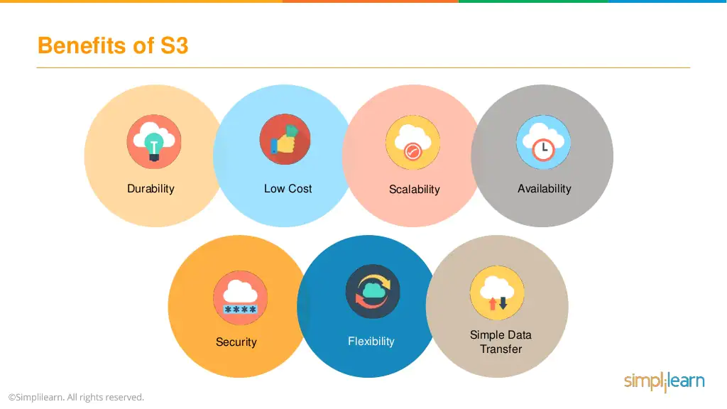

Slide 48
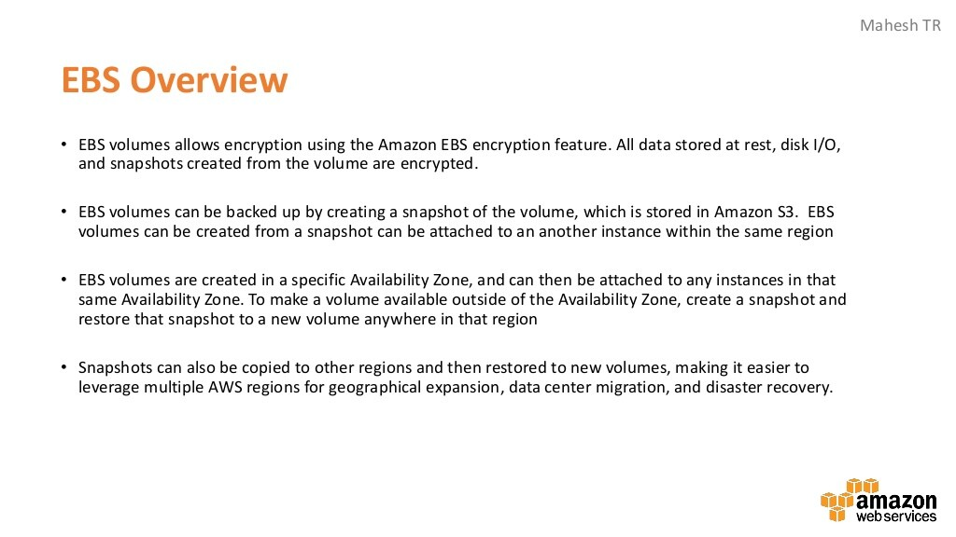

Slide 49
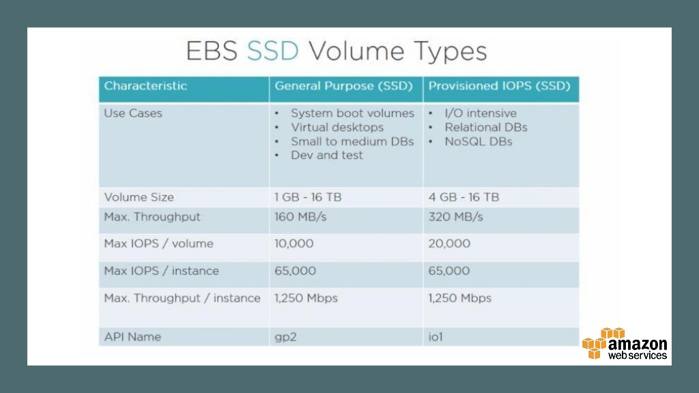

Slide 50
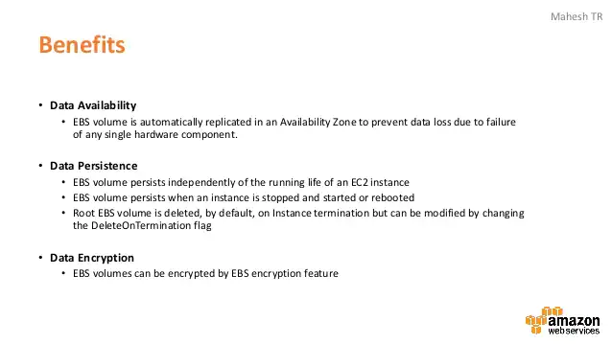

Slide 51
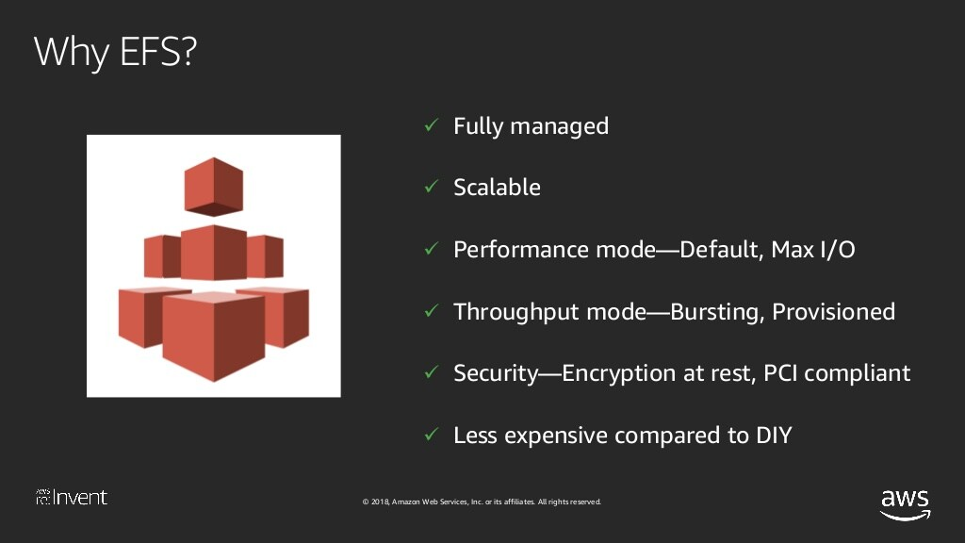

Slide 52
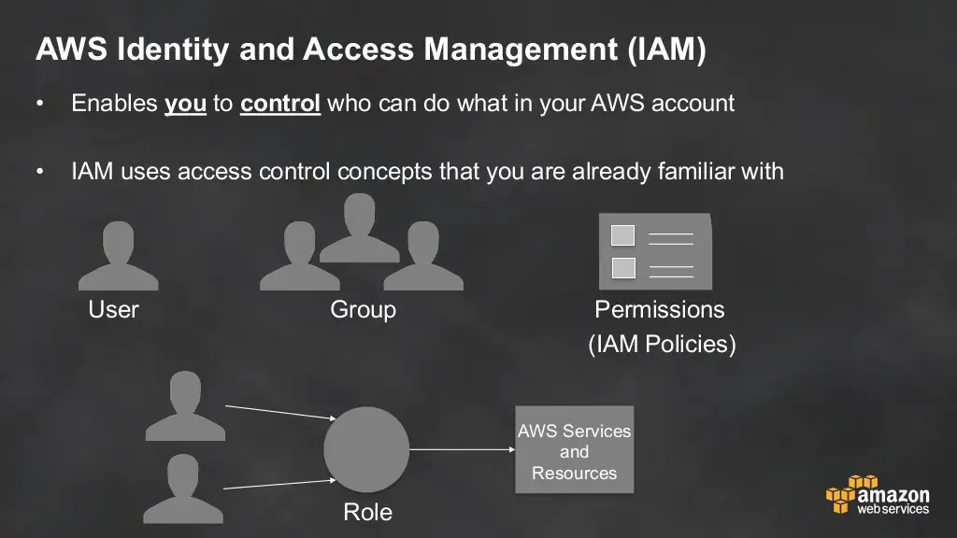

Slide 53
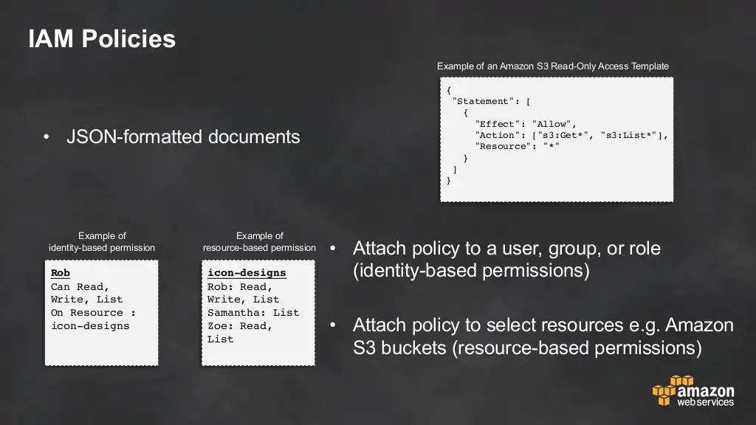

Slide 54
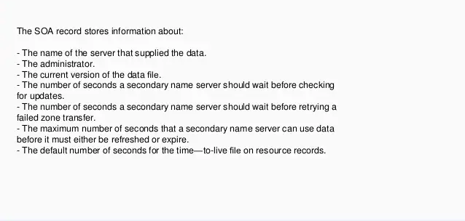
Route 53 : DNS SOA Record

Slide 55
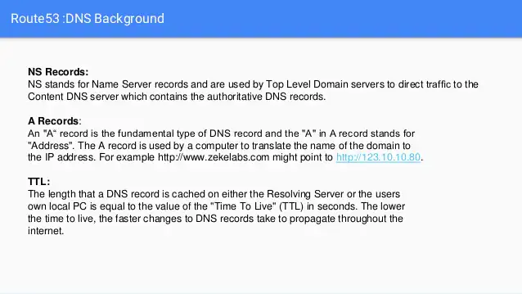
Route 53 : DNS records

Slide 56
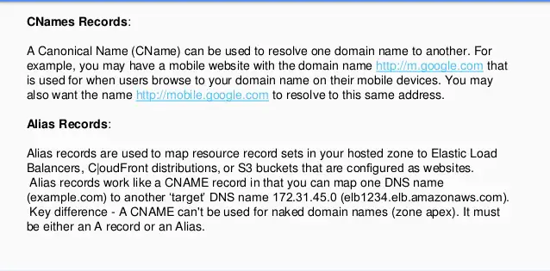
Route 53 : Other Records

Slide 57
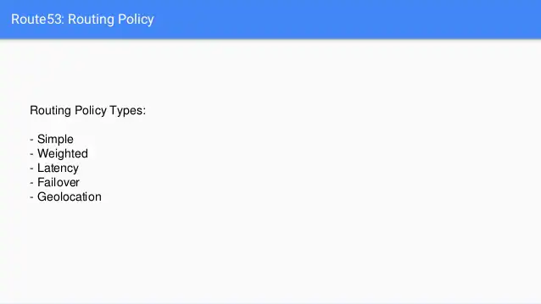
Route 53 : Routing Policy

Slide 58
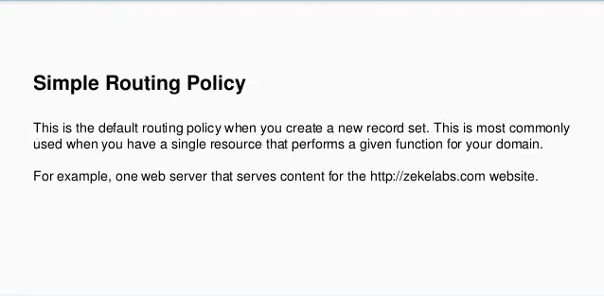
Route 53: Routing Policy Types

Slide 59
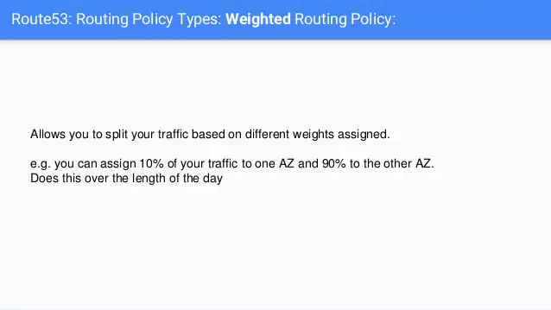
Route 53 : Weighted Routing Policy

Slide 60
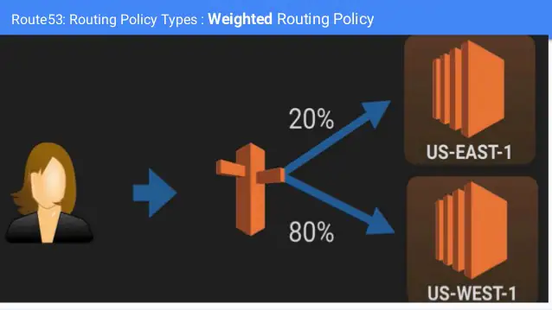
Route 53 : Weighted Routing Policy

Slide 61
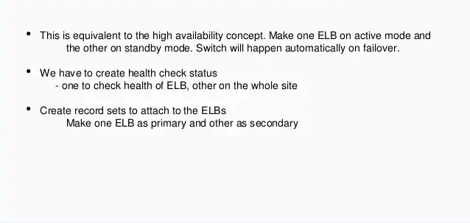
Route 53: Failover Routing Policy

Slide 62

Route 53 : Failover Routing Policy

Slide 63


Slide 64


Slide 65


Slide 66


Slide 67


Slide 68


Slide 69


Slide 70


Slide 71


Slide 72


Slide 73


Slide 74


Slide 75


Slide 76
Agenda for the Day
CloudFormation
CloudFront
Elastic Beanstack
Autoscaling
Ec2 Instance with Software Provisioning
Route 53

